Slide 1
Cyborg Ninja
By Lucas Ward- The totally unheard-of game idea

Slide 2
Cyborg Ninja
A 2D Platformer based around level completion via enemy clearing using movement and kunai to destroy the enemy robots.

Slide 3
Pitch
A super cool never before heard of game about a freaking ninja in a cyber world beating up robots. Fly through levels with wacky movement and sling kunai around to best your foes and discover many ways to clear even a single level as you uncover the truth behind who is sending these robots after your home.

Slide 4
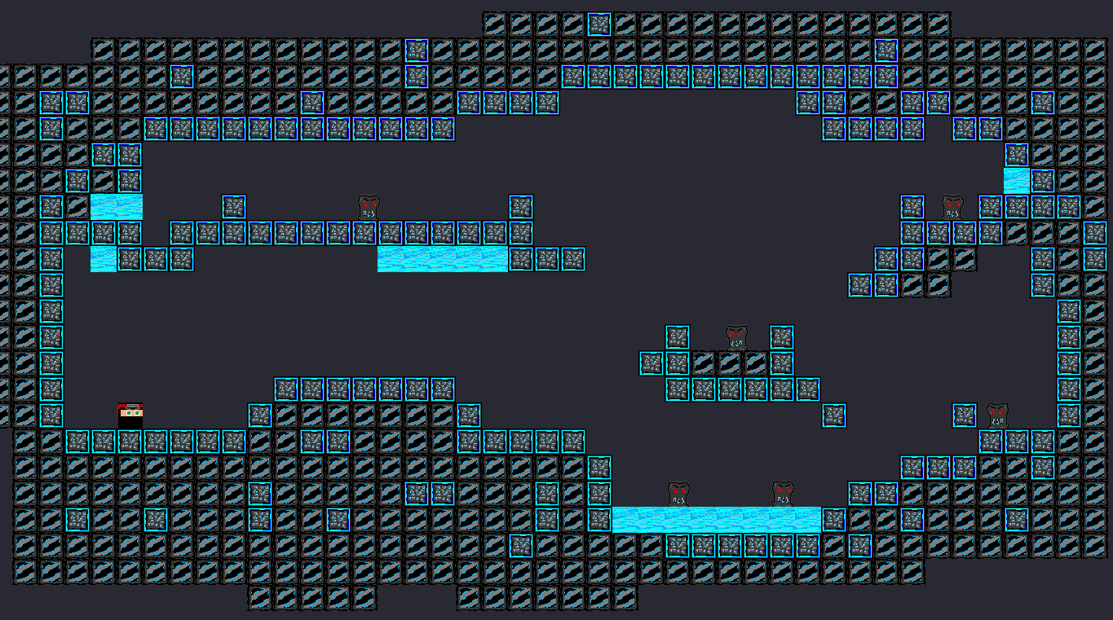
Setting
As mentioned, the super cool little ninja is running through multiple neon lit, cybernetic-esque levels filled with robotic enemies to clear. The setting is mostly darker with bright neon lights to contrast.

Slide 5
Genre
A 2D platformer with thrown projectiles and movement to defeat enemies to progress.

Slide 6
Game Engine
(Shockingly enough- ) This game will be using Game Maker Studio 2 for the entirety of its development thanks to the ease of creation using pixelated art-style.

Slide 7
Key Mechanics and Systems
Game will feature fast movement which can even kill enemy robots, but the ninja will also have thrown kunai as a weapon to defeat foes from afar. Levels will support fast paced play while providing escalating challenge through increased hazardous obstacles and enemy count.

Slide 8
The Story
The Legendary All Powerful Cyborg Ninja (Full Name), aka N1nja, is set out to defeat the evil robots that are approaching his home. What is causing these robots to keep appearing, and who is doing this horrible thing?? Keep beating up bad things to figure out everything seems to be N1nja’s strategy, so let’s see what secrets will be uncovered.

Slide 9

The Characters
The Legendary All Powerful Cyborg Ninja, aka N1nja (Protagonist)
Robots (Generic foes for the Protagonist to destroy ruthlessly)
??? (The really bad guy that caused it all…. But really who??)
Some even bigger robots? (Elite/ Boss encounters outside of the main bad guy. Names are discovered upon playing.)

Slide 10
The GUI
The interface will be simple, using a retro cybernetic style for displaying life (little ninja heads for heart system) along with a display on what weapon is equipped (because there will be different kunai for N1nja to use). There will also be a counter for how many enemies remain in a level.

Slide 11

The Art
Art style will follow a very bland environment with the only thing setting itself from darkness is the bright neon lights. The simple retro, pixelated style will provide the game with a loveable aesthetic for mindlessly speeding around breaking robots while doing ninja things.

Slide 12
Summary
Cyborg Ninja is meant to be a kind of silly game purely for entertainment while providing enough simple challenge so the player can’t be completely braindead. Provided the rapid killing of enemies and fast movement, the game supports some form of speed running potential even though it is not the main target. I hope that you enjoy this silly game enough to play it for quite some time.
Thank You!!

